Slide 1

Capstone Project – Data Science

Slide 2
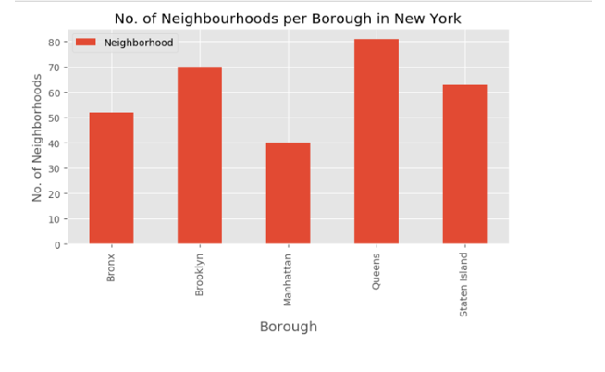
Neighbourhoods in each NY Borough

Slide 3
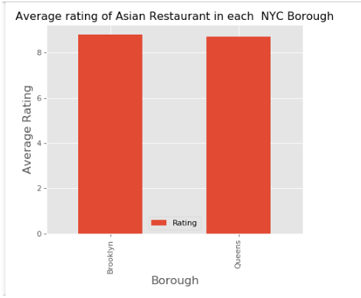
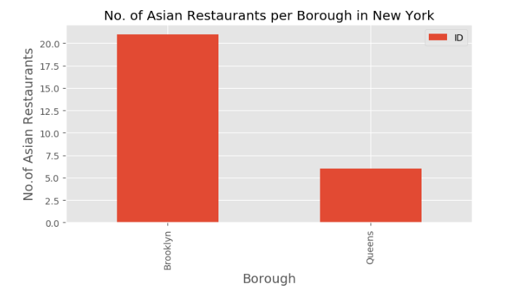
Asian Restaurants in Boroughs
Ratings for restaurants
No. of Asian Restaurants in each Borough
.

Slide 4
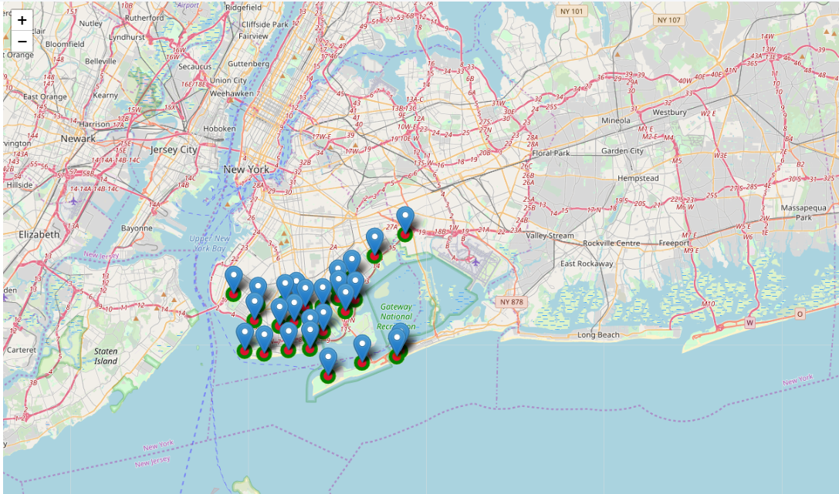
Asian Restaurants on Map

